Slide 1
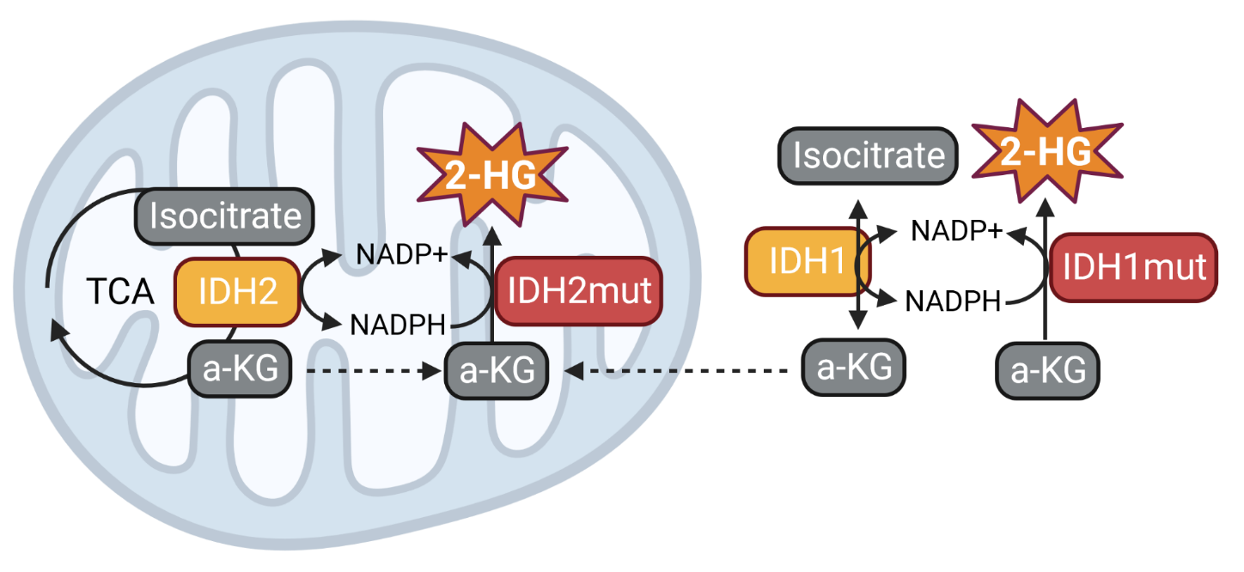

Slide 2
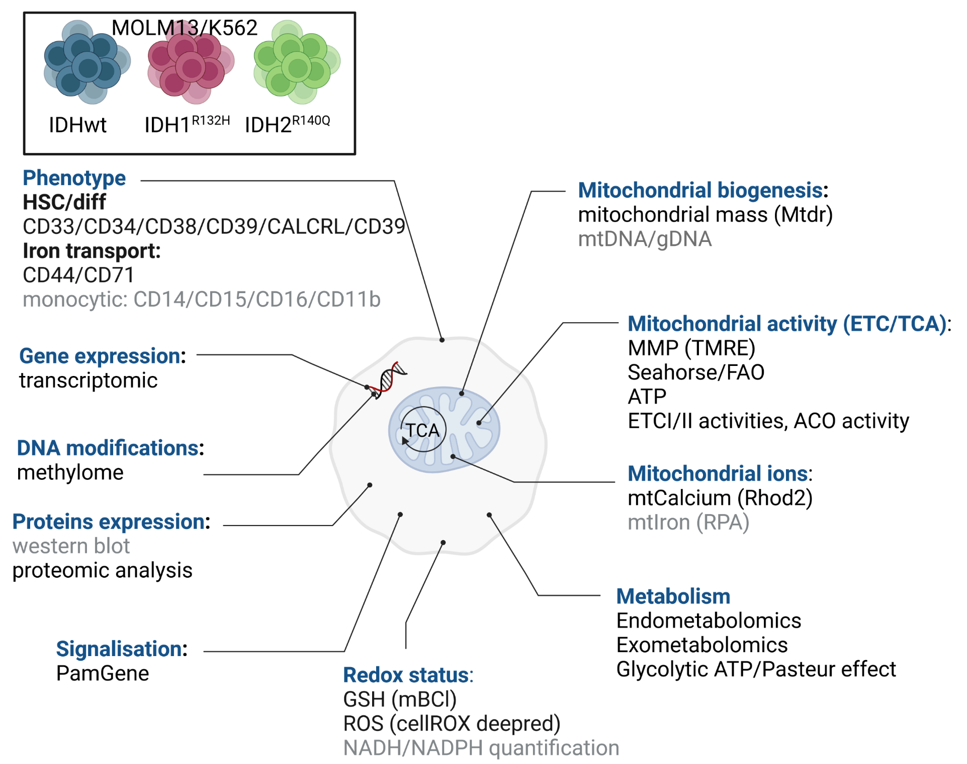

Slide 3
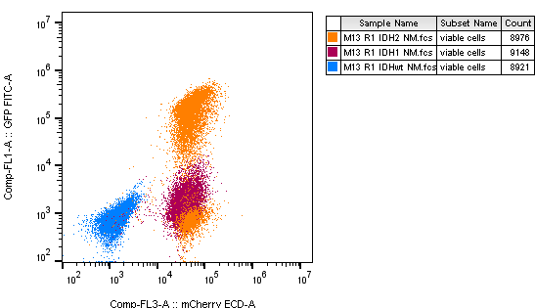
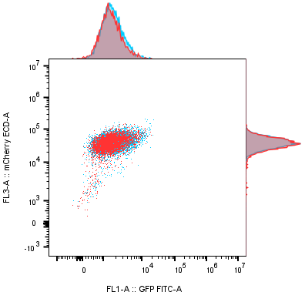
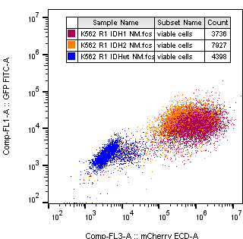
Pas hypermethylation?
Try 3-5 days treatment

Slide 4
Cell differenciation and phenotyping
CD33: monocytic marker
CD34: hematopoietic precursor cells of all lineages and most primitive pluripotential stem cells
CD38: differenciation marker.
CD39: ectonucleotidase. Showed as a marker of resistance by Nesrine and Emeline
CALCRL: Showed as a marker of resistance by Clément and Nathan
CD71: transferrin receptor. It mediates cellular iron uptake.
CD44: hyalurinin and osteopondin receptor. Described as a possible iron transporter.

Slide 6
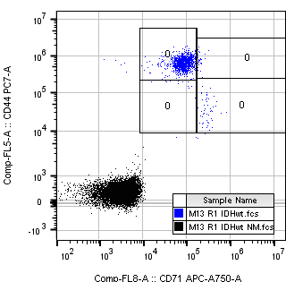
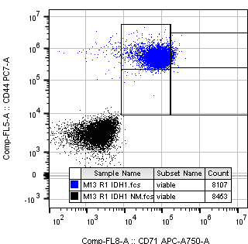
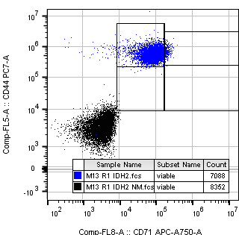

Slide 7
Redox status

Slide 8
Mitochondria activity
Mitochondria ions

Slide 9
MOLM13 and K562-IDH mutated models (Xu Lab). -> enzymatic activities
R1/R2: malonate inhibits 100% but TTFA inhibit max 30% of activity
V0 maintain activity – aspecific or error in mix préparation?

